Slide 1
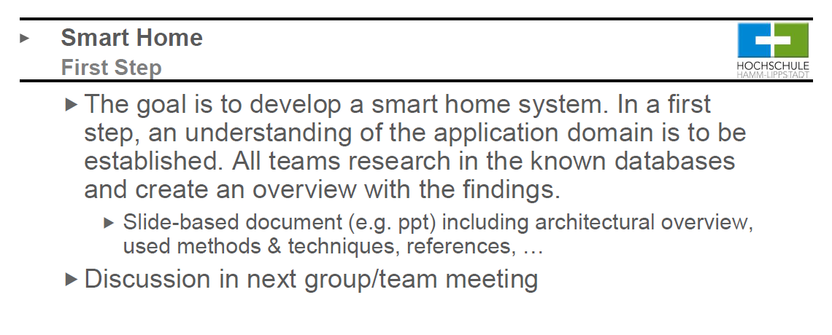
Add disadvantage and security sytem
Add system and protocol stage on architecture

Slide 2
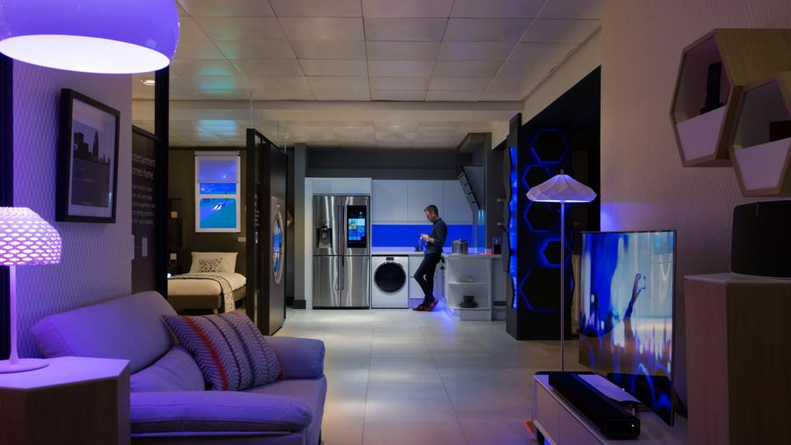

SMART HOME TuringJuniors
Members: Sheikh Muhammad Adib, Hadi Imran , Ammar Haziq, Evrard, Zafirul Izzat

Slide 3

SMART HOME
Devices connected within a network[7]
Hadi Imran

Slide 4
Application Domain
Home Lighting
Home Security
Home heating
Home entertainment
Ammar Haziq

Slide 5
Method and techniques
Smart Communications
Home Service Bus[5]
Wireless technology[1]
Smart Hubs support various protocol
Smart Operations
Need Home network controller and service platform[5]
Able to control connected device with one device.
Smart Interactivity
Share collected information to other devices
Each device can control each other[1]
Data reprository[6]
Sheikh Muhammad Adib

Slide 6
Architechture
System
Uber, Amazon
Cisco switch
Microsoft Asure, google drive, AWS cloud
O2, telecom mobile
API and IoT gateway
Bluetooth 5.0,4.0
Ethernet, 802.11ac IP
Phones, smart homes, cars, speakers
Vocal, Temperature sensors
Routers, switches
Cloud
DSL, WIFI, mobile, fibres
Gateway
Bluetooth, infrared rays, NFC
Protocol
Sensors, actuators
Things
Evrard Leuteu

Slide 7
Goals & Benefits
Saving Time and Effort[1]
Saving Money and Conserving Energy[1]
Can do more[1]
Improve scurity[3]
Zafirul Izzat

Slide 8
Cons
Increase dependence on outside experts[3]
Increase dependence on electricity networks(internet)[3]
Can be easily attack(security)[4]

Slide 9
Reference
[1] Miller, M., n.d. My Smart Home For Seniors.
[2] A. F. Einarsson, P. Patreksson, M. Hamdaqa and A. Hamou-Lhadj, "SmartHomeML: Towards a Domain-Specific Modeling Language for Creating Smart Home Applications," 2017 IEEE International Congress on Internet of Things (ICIOT), Honolulu, HI, 2017, pp. 82-88, doi: 10.1109/IEEE.ICIOT.2017.35.
[3]Wilson, Charlie & Hargreaves, Tom & Hauxwell-Baldwin, Richard. (2017). Benefits and risks of smart home technologies. Energy Policy. 103. 72-83. 10.1016/j.enpol.2016.12.047.
[4] M. Schiefer, "Smart Home Definition and Security Threats," 2015 Ninth International Conference on IT Security Incident Management & IT Forensics, Magdeburg, 2015, pp. 114-118, doi: 10.1109/IMF.2015.17.
[5] X. Xu, Y. Tao, X. Wang and X. Ding, "Research on Architecture of Smart Home Networks and Service Platform," 2014 5th International Conference on Digital Home, Guangzhou, 2014, pp. 232-236, doi: 10.1109/ICDH.2014.51.,Results 1 - 12 of 4000+ — CompTIA Network+ Certification All-in-One Exam Guide, Seventh Edition (Exam N10-007),Cisco Routers for the Desperate: Router and Switch Management, the Easy Way: Michael W. Lucas: 0689145719307: Amazon.com: Books., Big Book of Border Gateway Protocol (BGP) RFCs (The Big Books Series) [Loshin, Pete],
[6] T. Balikhina, A. A. Maqousi, A. AlBanna and F. Shhadeh, "System architecture for smart home meter," 2017 2nd International Conference on the Applications of Information Technology in Developing Renewable Energy Processes & Systems (IT-DREPS), Amman, 2017, pp. 1-5, doi: 10.1109/IT-DREPS.2017.8277811.
[7] M. Schiefer, "Smart Home Definition and Security Threats," 2015 Ninth International Conference on IT Security Incident Management & IT Forensics, Magdeburg, 2015, pp. 114-118, doi: 10.1109/IMF.2015.17.

